Slide 1

Tompkins County SS4A Joint Safety Action Plan Virtual Public Meeting
April 30, 2025
Cambridge Systematics, Inc.
with TYLin
FHI Studio
Planning4Places
Visit safestreetstompkins.com
for more information

Slide 2
Agenda
Project Overview
Draft Plan & Executive Summary Public Review Period
What to Expect: Draft Joint Safety Action Plan
What to Expect: Executive Summary
Q & A

Slide 3
Project Overview

Slide 4
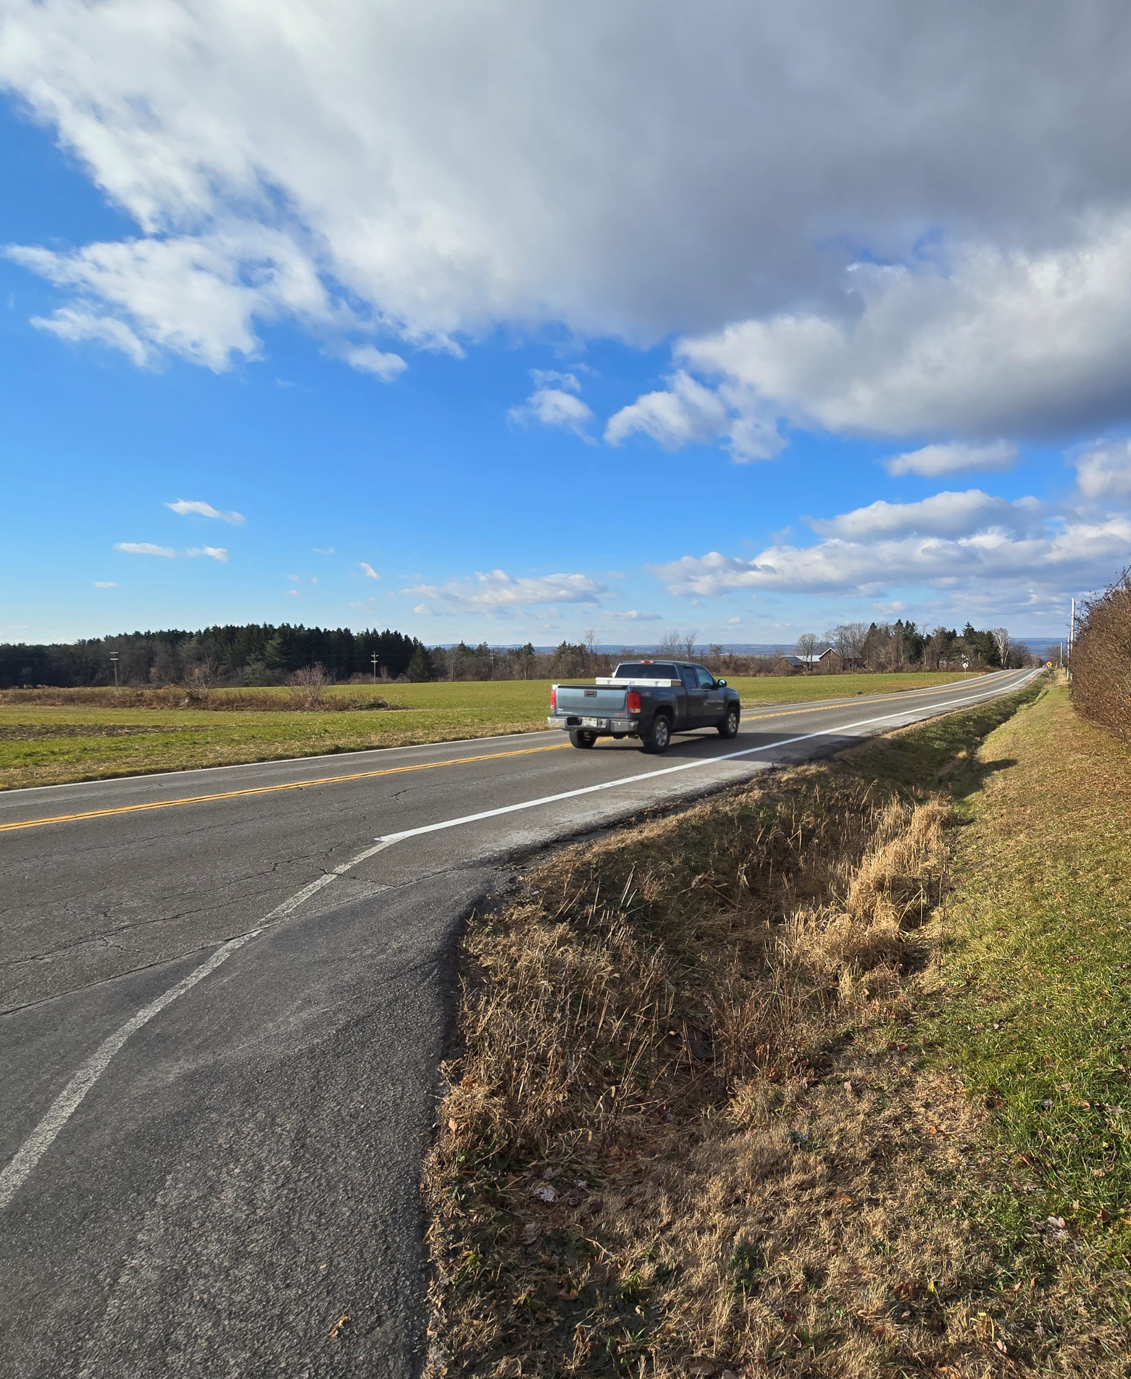
What is Safe Streets for All (SS4A)?
The Safe Streets for All (SS4A) grant is a federal program created under the Bipartisan Infrastructure Law. It provides funding to local, regional, and tribal governments to:
Design and implement strategies that prevent roadway deaths and serious injuries.
Improve safety for everyone – whether walking, biking, driving, or using transit.
Support the creation of comprehensive safety action plans, including traffic calming, speed management, safer crossings, and complete streets initiatives.

Slide 5
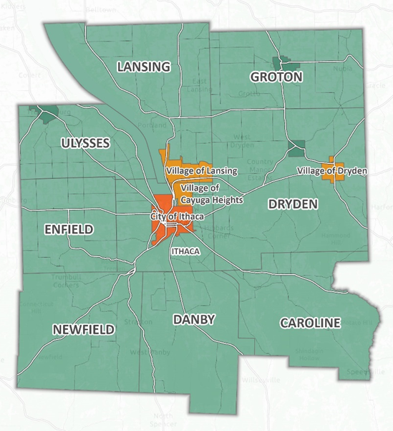
Tompkins County
Purpose of the Project
Develop a comprehensive SS4A Joint Safety Action Plan for Tompkins County
Provide recommendations for prioritized locations to help improve safety and strategies for eliminating fatalities and serious injuries throughout the region
Lay the groundwork to successfully procure SS4A Implementation Grants
Tompkins County and ten municipalities within Tompkins County have come together to prepare the Joint Safety Action Plan

Slide 6



Project Team
Jurisdictions in Tompkins County*
*With support from ITCTC and NYSDOT
Tompkins County
City of Ithaca
Town of Ithaca
Village of Cayuga Heights
Town of Caroline
Town of Danby
Town of Dryden
Village of Dryden
Town of Lansing
Village of Lansing
Town of Newfield
Consultant Team

Slide 7
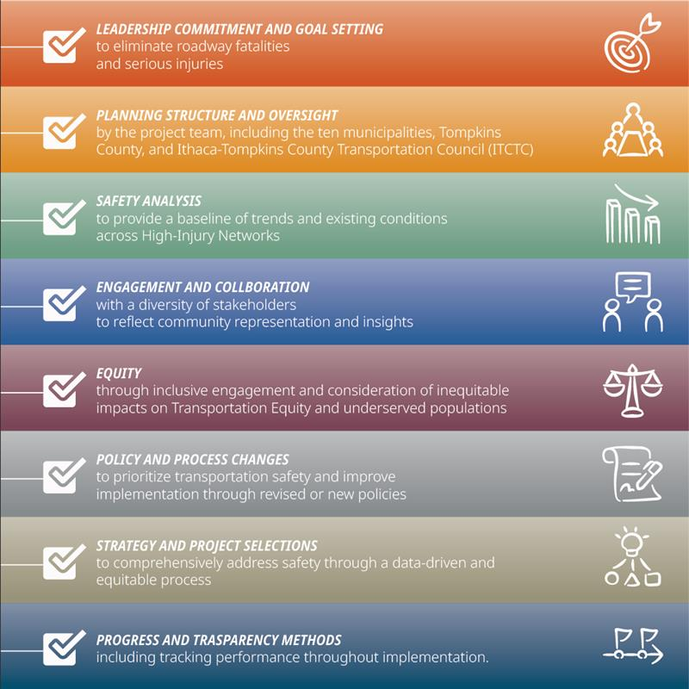
Joint Safety Action Plan Requirements

Slide 8
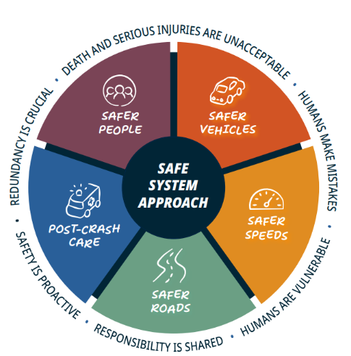
Safe System Approach
New York State adopted FHWA’s Safe System Approach for its transportation system.
NY SHSP’s Vision:
“New York State strives for an equitable and sustainable transportation system that works towards zero fatalities and zero serious injuries for all roadway users.”

Slide 9
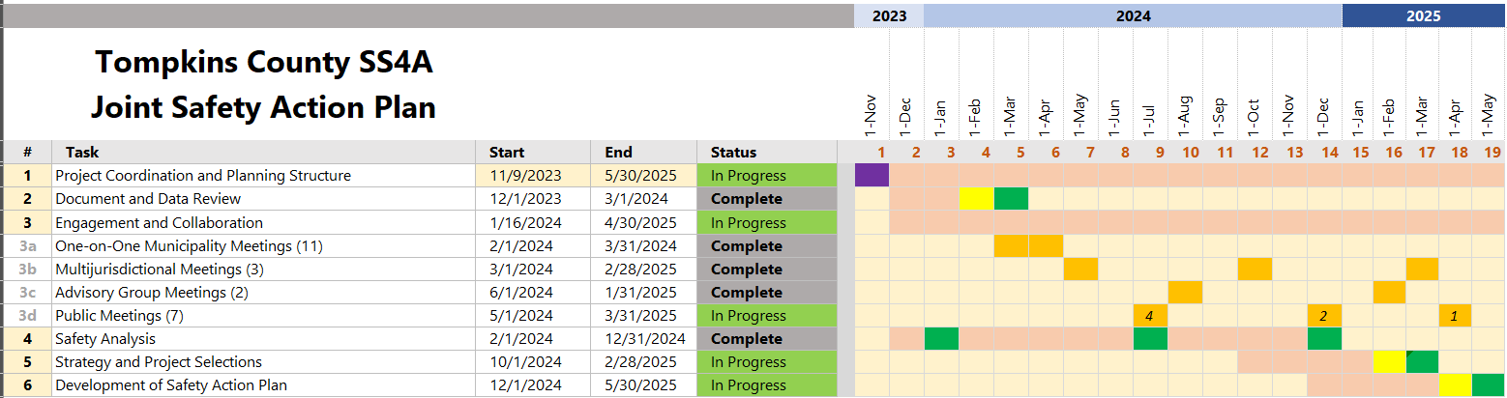
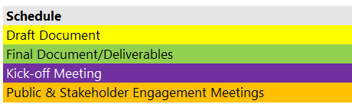
Project Schedule

Slide 10

Draft Plan & Executive Summary Public Review Period April 30 – May 14

Slide 11
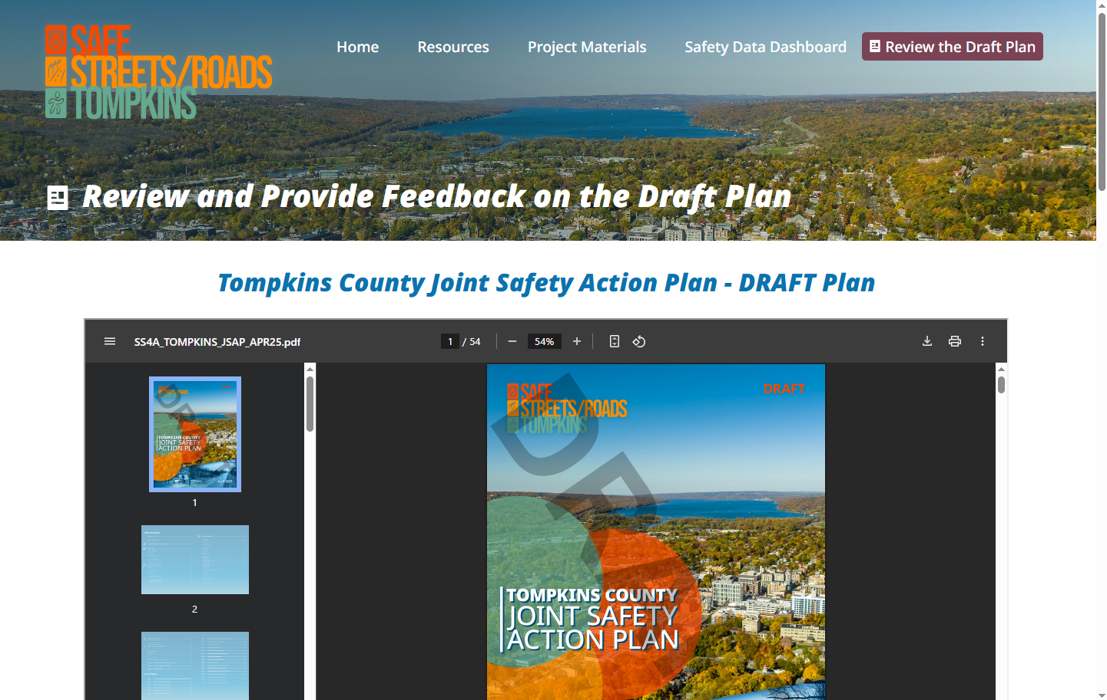
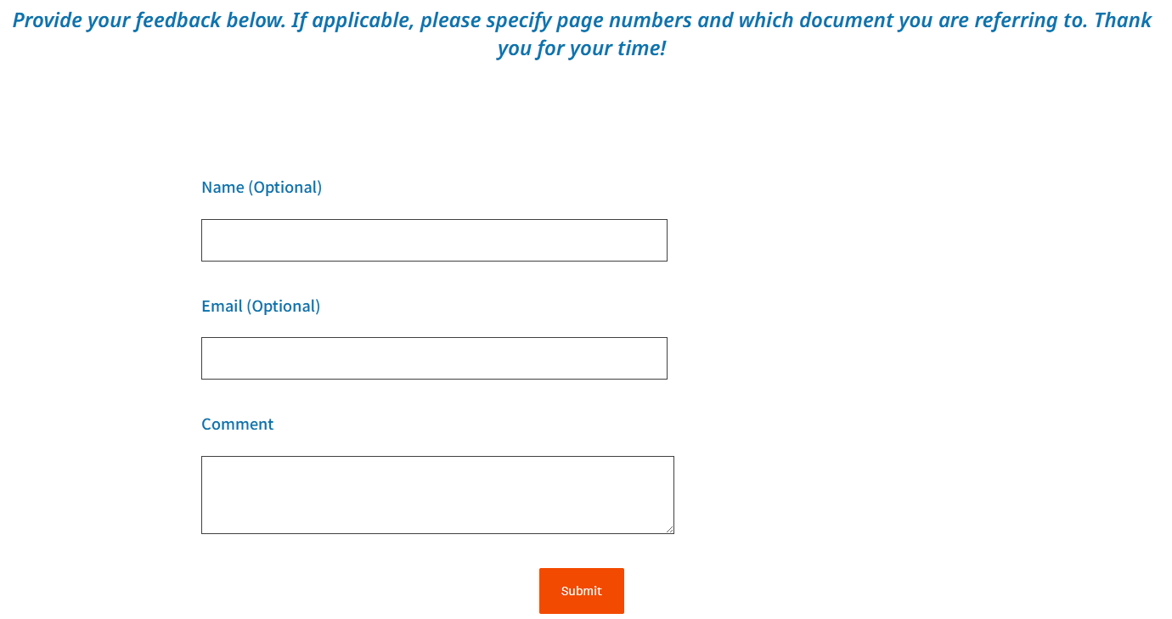
We Want to Hear from You!
What?
Your comments on the Draft Tompkins County SS4A Joint Safety Action Plan and/or Executive Summary
When?
April 30 (today) through May 14
Where?
Safestreetstompkins.com/review-plan
How?
Submit your thoughts in the comment box

Slide 12
What to Expect: Draft Joint Safety Action Plan

Slide 13
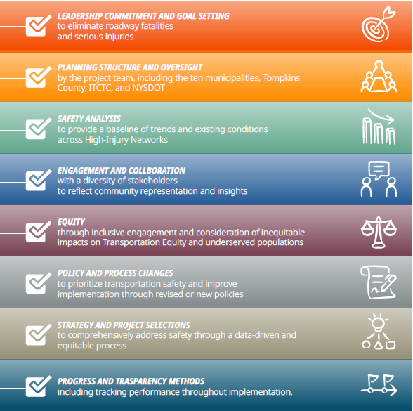
Plan Sections:
Joint Safety Action Plan Requirements

Slide 14

Leadership Commitment & Goal Setting

Slide 15
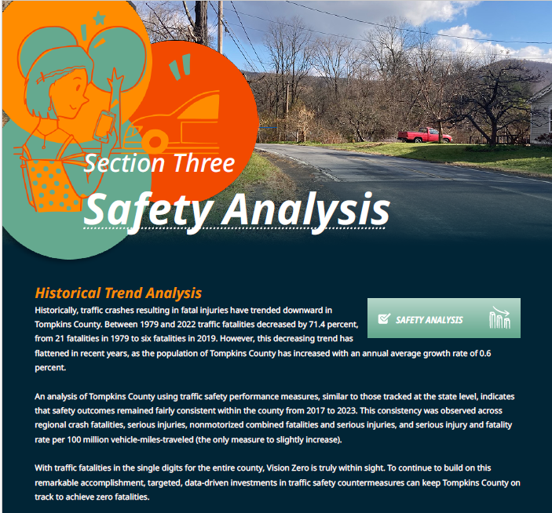
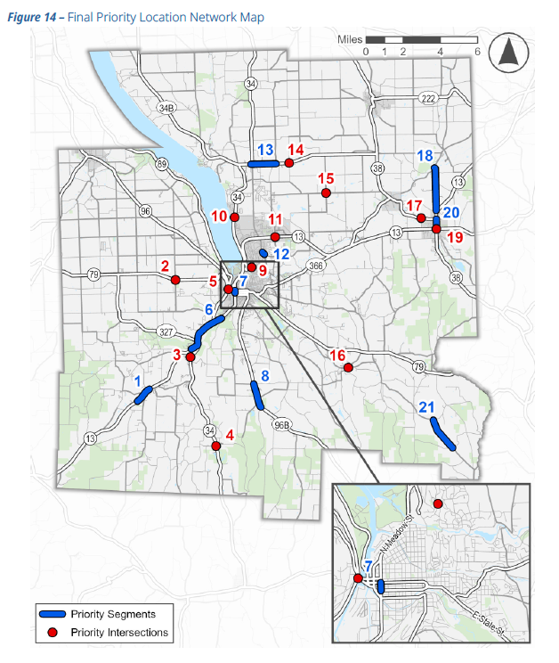
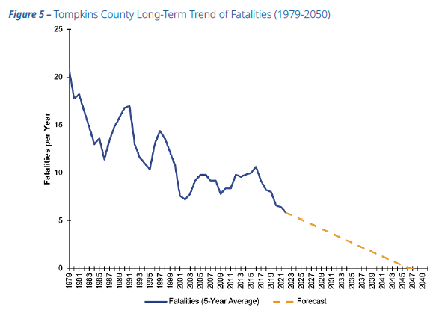
Safety Analysis

Slide 16
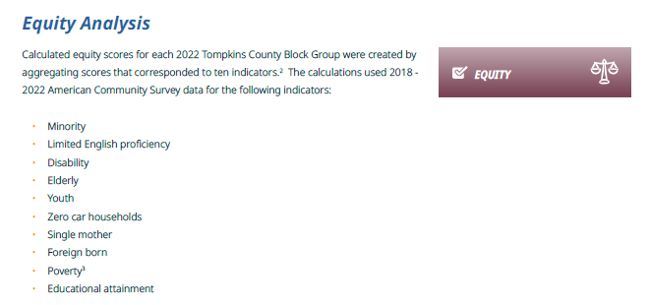
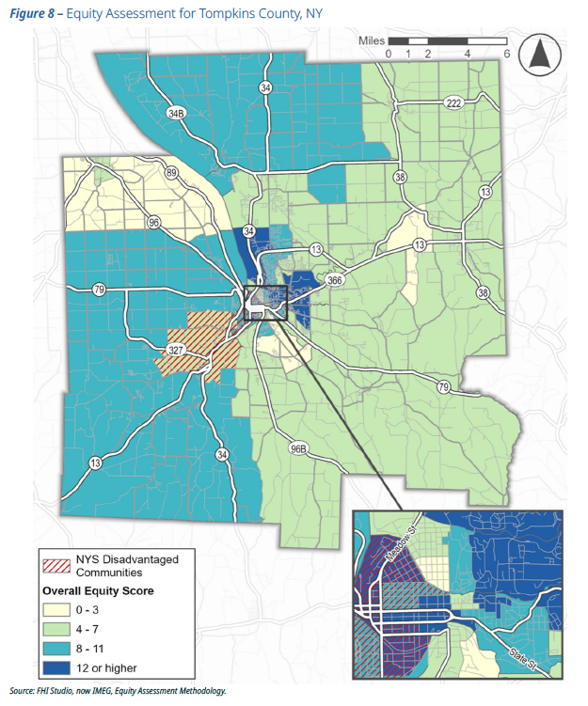
Equity Analysis

Slide 17

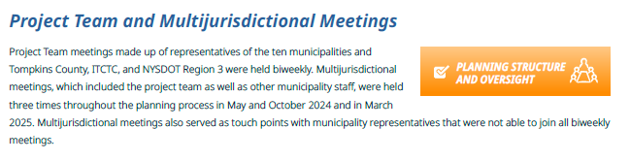
Engagement and Collaboration &
Planning Structure and Oversight

Slide 18
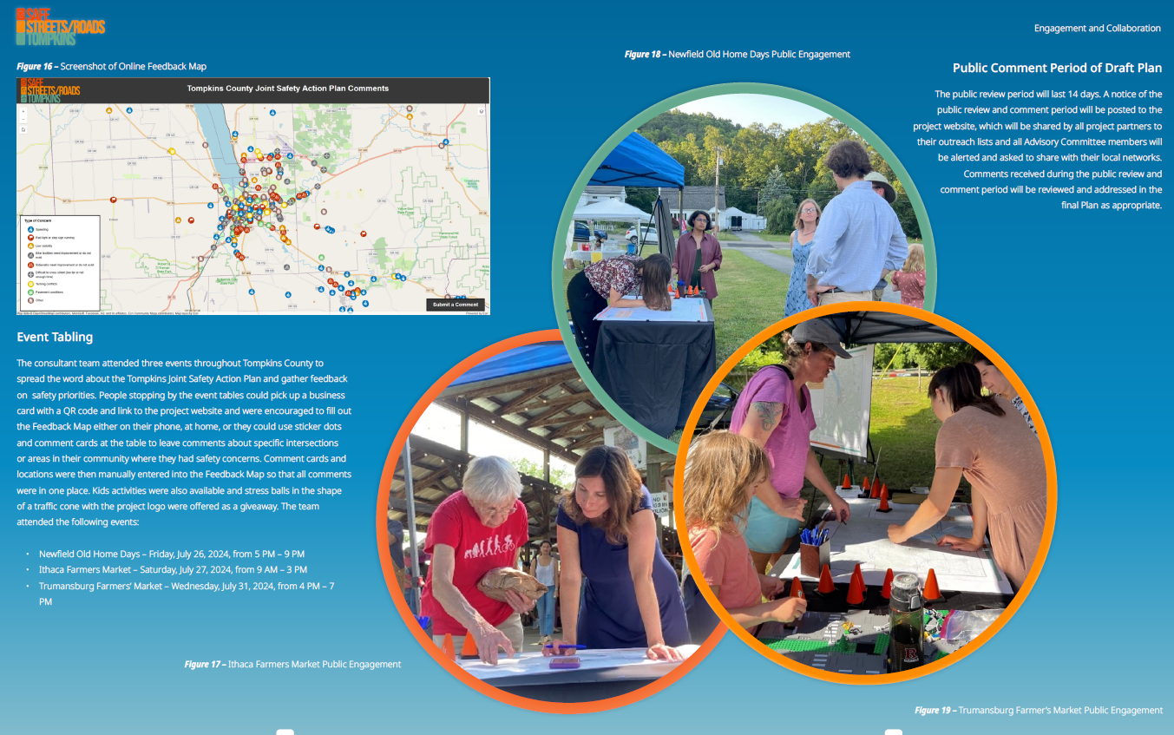
The online feedback map and comments in public meetings, email, and through the website contributed to:
Priority locations and suggested recommendations
Emphasis Areas and related strategies
Stakeholder decisions and process changes
Engagement & Collaboration: How was public input used?

Slide 19
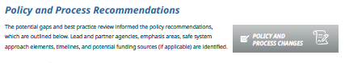
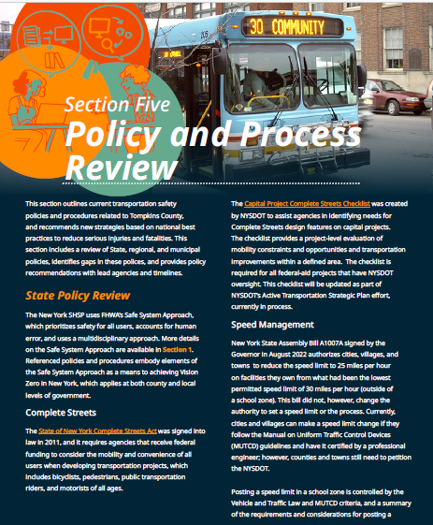
Project Development
Complete Streets
Reduce Speed Limits
Vision Zero Action Plan & Data Monitoring
Design Standards
Safe Routes to School
Education
Traffic Violation Monitoring Systems
Speed Monitoring Displays
Vulnerable Road Users & Equity
Work Zone Safety
Data
Policy & Process Review

Slide 20
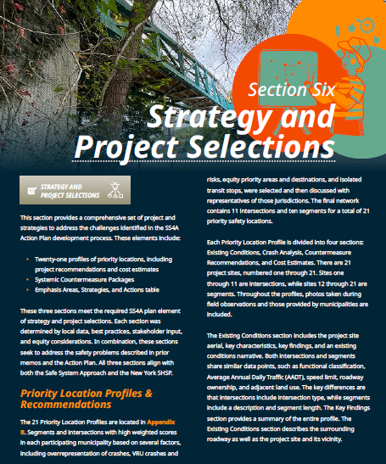
The Appendix of the Plan includes:
21 profiles of priority locations, including project recommendations and cost estimates (Final Plan)
Systemic Countermeasure Packages
Emphasis Areas, Strategies, and Action table
Strategy & Project Selection

Slide 21
Based on public feedback, the NY SHSP, Tompkins County crash data, municipality input, and more, the following were chosen as Emphasis Areas for this Plan:
Strategy & Project Selection: Emphasis Areas
Intersections
Roadway Departures
Vulnerable Road Users
Age-Related
Road User Behavior

Slide 22
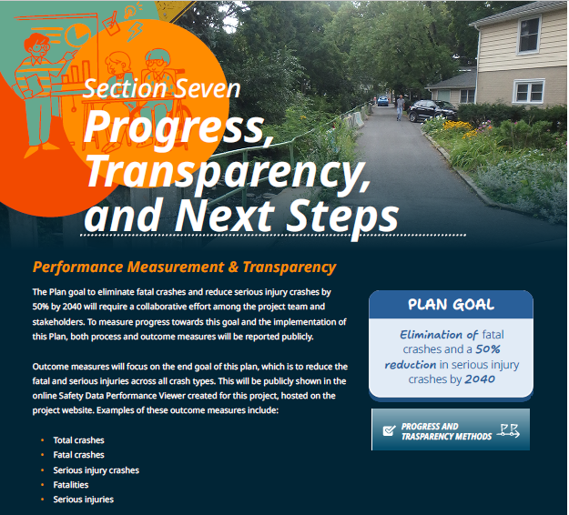
Progress, Transparency, & Next Steps
Track local crash stats in the Safety Performance Data Viewer at safestreetstompkins.com!

Slide 23
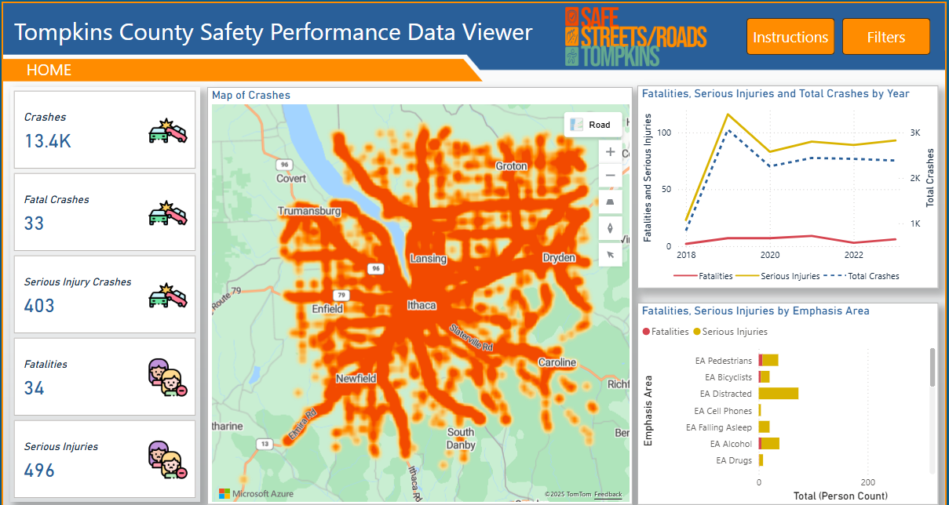
Home

Slide 24
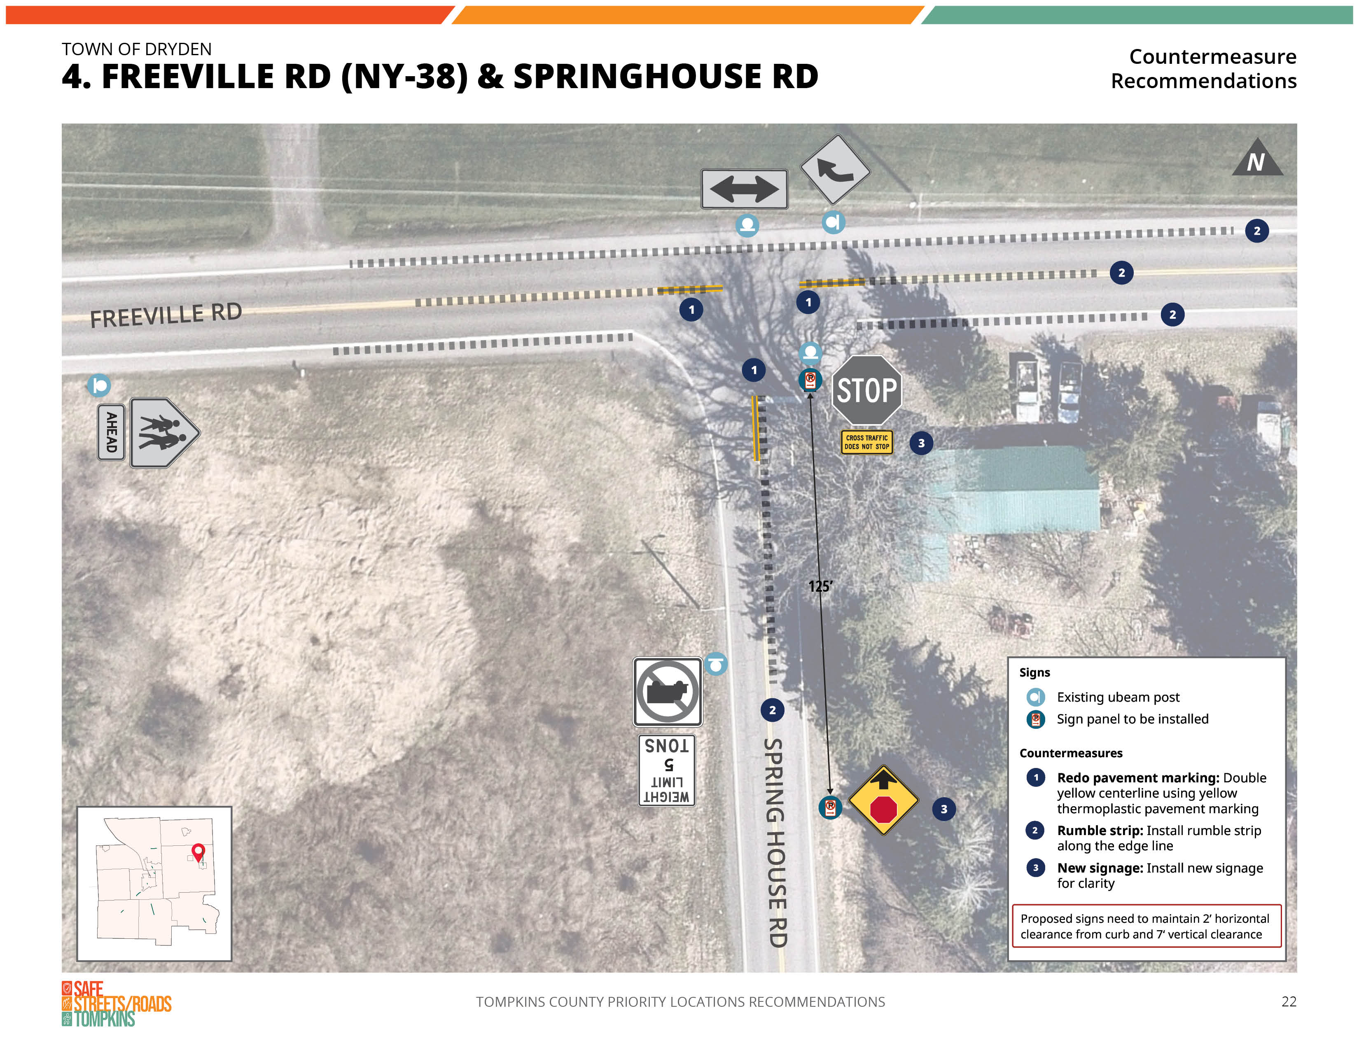
Appendices
Appendix A (Final Plan)
Signed jurisdiction resolutions adopting this Plan, this Plan Goal, and Vision Zero
Appendix B (Final Plan)
Priority location profiles and recommendations
Appendix C
Systemic Countermeasure Packages
Appendix D
Full table of actions organized by Emphasis Areas and strategies

Slide 25
What to Expect: Draft Plan Executive Summary

Slide 26

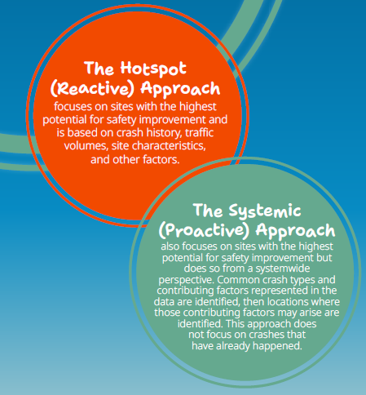
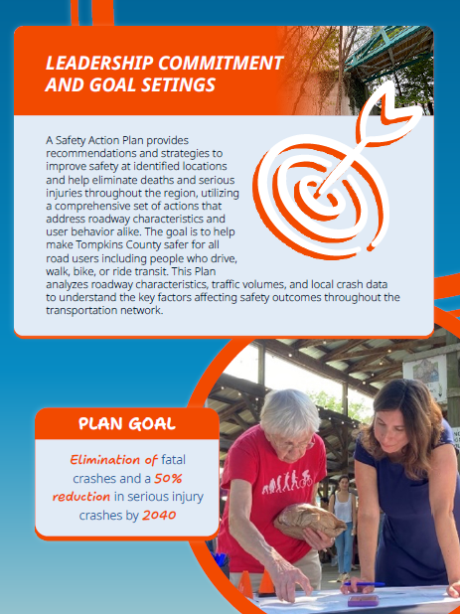
Executive Summary
12 pages compared to 61 pages + appendices

Slide 27
We Want to Hear from You!
What?
Your comments on the Draft Tompkins County SS4A Joint Safety Action Plan and/or Executive Summary
When?
April 30 (today) through May 14
Where?
Safestreetstompkins.com/review-plan
How?
Submit your thoughts in the comment box

Slide 28
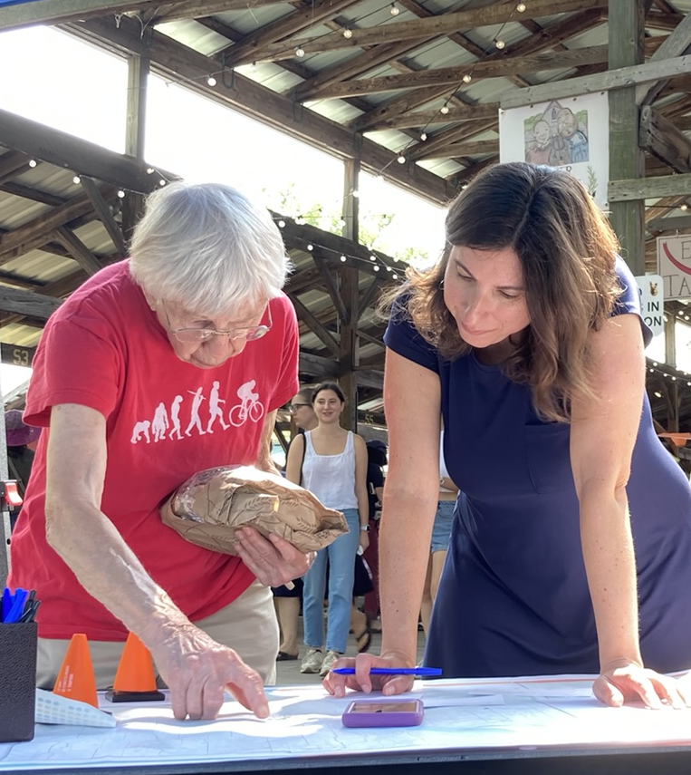

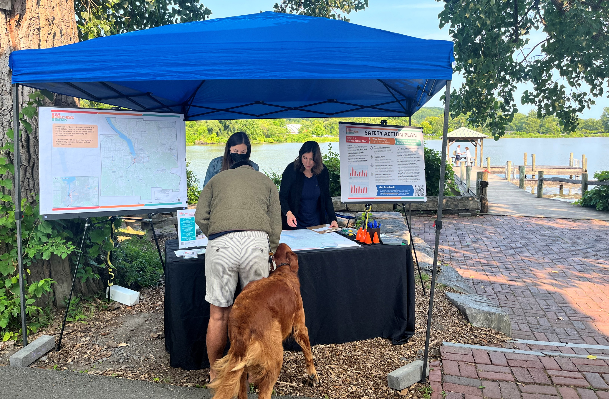
Thank you for your input throughout this process!

Slide 29
Questions?
Visit safestreetstompkins.com
for more information

